Slide 1

CUSTOMER SEGMENTATION ANALYSIS
Mini Project
Fiska Hendiyaningsih​

Slide 2
Business understanding
A marketing division wants to hold a customer loyalty program. However, previously there was no clear strategy regarding what kind of segment should be made so that this program is right on target, so analysts were asked to analyze and determine customer segmentation and provide recommendations related to loyalty programs.
Business QUESTION
Whether the number of children (kid or teen) and income have an influence on the frequency and value of transactions.
Are there more purchases through the store than purchases through the catalog or the web, and what customer criteria make purchases on the channel the most?
What is the optimal number of clusters?
Customer profile of each cluster
Do campaigns that have existed tend to be accepted by certain customer groups?
GOAL
Build a customer segmentation model to determine the profile of each cluster
Give recommendations for loyalty programs from the customer profile
SOLVING
There are four groups / clusters formed from the K-Means model based on the number of children owned, income, spending for each type of product, recency, and frequency of purchase.

Slide 3
Data Source Explanation
Link Source: https://www.kaggle.com/datasets/jackdaoud/marketing-data
Column Details:
Income : customer's yearly household income
Kidhome : number of small children in customer's household
Teenhome : number of teenagers in customer's household
Recency : number of days since the last purchase
MntWines : amount spent on wines in the last 2 years
MntFruits : amount spent on fruits in the last 2 years
MntMeatProducts : amount spent on meat products in the last 2 years
MntFishProducts : amount spent on fish products in the last 2 years
MntSweetProducts : amount spent on sweet products in the last 2 years
MntGoldProds : amount spent on gold products in the last 2 years
NumDealsPurchases : number of purchases made with discount
NumWebPurchases : number of purchases made through company's web site
NumCatalogPurchases : number of purchases made using catalogue
NumStorePurchases : number of purchases made directly in stores
NumWebVisitsMonth : number of visits to company's web site in the last month
AcceptedCmp3 : if costumer accepted the offer in the 3rd campaign, 0 otherwise
AcceptedCmp4 : 1 if costumer accepted the offer in the 4th campaign, 0 otherwise
AcceptedCmp5 : 1 if costumer accepted the offer in the 5th campaign, 0 otherwise
AcceptedCmp1 : 1 if costumer accepted the offer in the 1st campaign, 0 otherwise
AcceptedCmp2 : 1 if costumer accepted the offer in the 2nd campaign, 0 otherwise
Complain : 1 if costumer complained in the last 2 years
Response (target) : 1 if costumer accepted the offer in the last campaign, 0 otherwise
Marital : customer's marital status
Education : customer's level of education
DtCustomer : date of customer's enrollment with the company

Slide 4

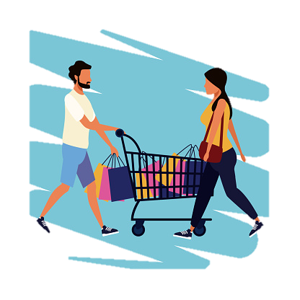
Total Customer who have children (kid or teen) is 2.5 x more than customers who do not have children.
Even though the number of customers is less, that mean spending value of customers who do not have children is $1,105/customer or 2.7 x more than those who have.

Slide 5
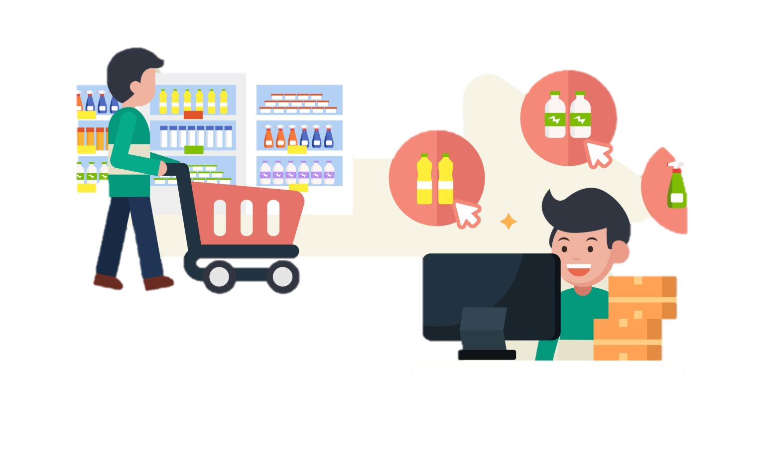
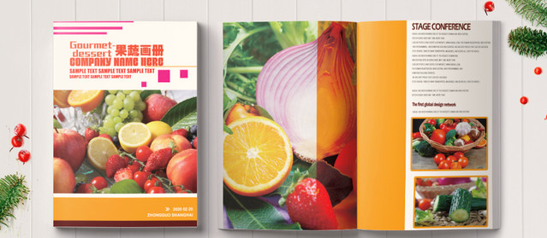
Average Purchase Frequency
STORE
No Kid or Teen : 7 - 8 times
With Kid or Teen : 5 - 6 times
WEBSITE
No Kid or Teen : 4 - 5 times
With Kid or Teen : 3 – 4 times
CATALOG
No Kid or Teen : 4 - 5 times
With Kid or Teen : 1 - 2 times
“Customers who have children or not on average, shop more often by coming directly to the store, compared to shopping through catalogs or websites”

Slide 6
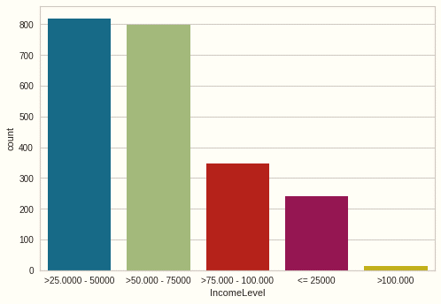
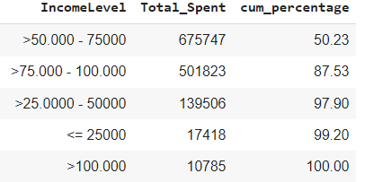

Income Level To Sales Contribution
But interestingly, 87% of sales contribution came from level 2 & level 3
818
797
1
346
2
3
242
4
13
Customers with level 1 (income 25,000 - 50,000) are 3% more than customers with level 2.

Slide 7
With only one variable ( have or no have children) can show the tendency of shopping behavior, how come if there were other variables such as income, the type of product purchased.
Based on this marketing data, there are seven types of products purchased by customers. there are Wine, Fruit, Meat Products, Fish Products, Sweet Products, and Gold Products.
We need to know what the customer profile looks like from what they buy, whether they buy fruit or meat more often, and whether there are certain preferences from each purchase of these types of products.
Then from the data there are also five kinds of campaigns that have been offered to customers. Clustering makes it easy to see if this campaign is likely to be followed by a particular customer cluster or not. So that in the future marketing channels and campaigns will be more adjusted to the customer profiles that have been grouped.

Slide 8
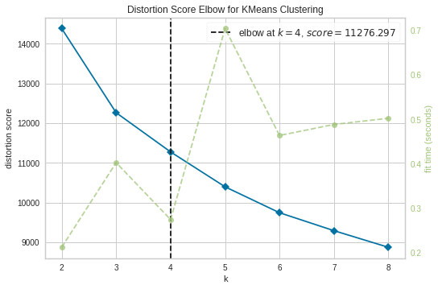
Optimal Number of Cluster
The optimal number of clusters according to the Elbow method is 4 clusters with these following group:
Cluster 0 : 613 Customer
Cluster 1 : 515 Customer
Cluster 2 : 574 Customer
Cluster 3 : 501 Customer

Slide 9
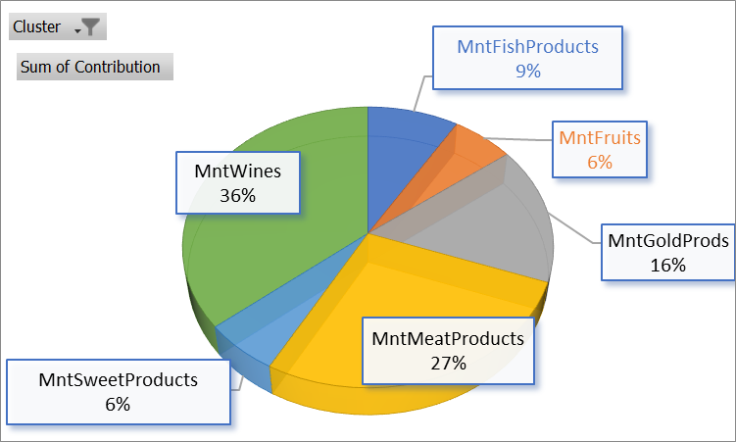
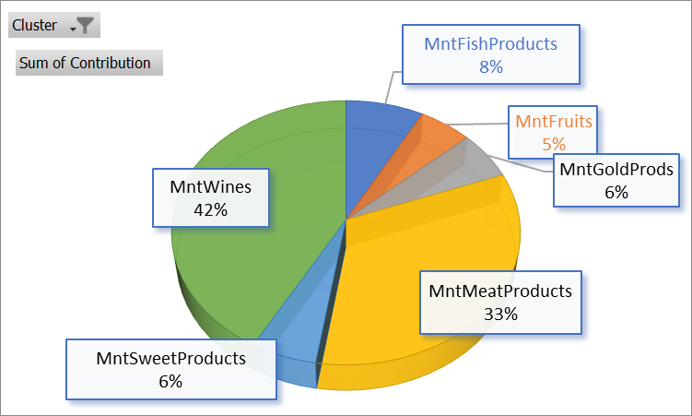
Cluster Customer Profile (1)
Income mean : $30.422
No teen at home or only have kid at home
Recency : 40
Spending value : $126
Rate web purchase : 2-3 times
Rate Catalog purchase : 0 -1 times
Rate Store purchase : 3-4 times
Deal Purchase : 1-2 times
Income mean : $74.957
No kid at home or only have teen at home
Recency : 50
Spending value : $1.396
Rate web purchase : 5-6 times
Rate Catalog purchase : 5-6 times
Rate Store purchase : 8-9 times
Deal Purchase : 1-2 times
Cluster 0
Cluster 1

Slide 10
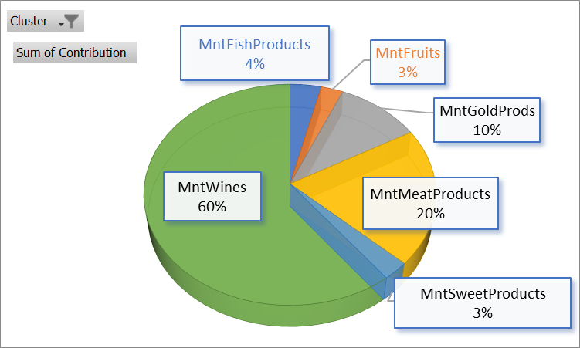
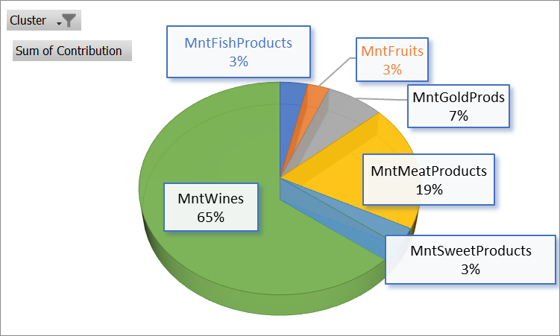
Cluster Customer Profile (2)
Income mean : $43.009
Have kid and teen at home
Recency : 49
Spending value : $170
Rate web purchase : 2-3 times
Rate Catalog purchase : 0 -1 times
Rate Store purchase : 3-4 times
Deal Purchase : 2-3 times
Income mean : $62.956
No kid at home or only Have teen at home
Recency : 47
Spending value : $880
Rate web purchase : 6-7 times
Rate Catalog purchase : 3-4 times
Rate Store purchase : 8-9 times
Deal Purchase : 2-3 times
Cluster 2
Cluster 3

Slide 11

Campaign Acceptance Tendency
Campaign 1
Top Cluster accept Campaign 1 :
Cluster 2 : 99 customer (71%)
Cluster 3 : 32 customer (23%)
Campaign 4
Top Cluster accept Campaign 4 :
Cluster 3 : 89 customer (55%)
Cluster 1 : 42 customer (26%)
Campaign 2
Top Cluster accept Campaign 2 :
Cluster 3 : 17 customer (59%)
Cluster 1 : 10 customer (34%)
Campaign 5
Top Cluster accept Campaign 5 :
Cluster 1 : 111 customer (70%)
Cluster 3 : 47 customer (30%)

Slide 12
Summary
Due to the tendency of the type of product purchased. The average number of expenditures for wine and meat products between Cluster 0 and Cluster 1 is similar. Likewise with Cluster 2 and Cluster 4.
We can say that Cluster 1 is the premium version of Cluster 0, because despite having the same product type tendency, customers from Cluster 1 have much higher purchasing power and spending compared to Cluster 0.
Although cluster 1 has the smallest income and value spending rates, only this cluster has the highest gold purchase tendency, reaching 16%, much different from cluster 1, this cluster premium rate of gold type is only 6%. Another interesting thing is that even though the income and expenses are small, customers in cluster 1 almost rarely make purchases with discounts (0-1) only once.
The frequency of purchases through stores is dominated by clusters 1 and 3 which reach 8-9 times per customer. Compared to cluster 0 and cluster 2 only 3-4 times. This can happen because the purchasing power of clusters 1 and 3 is much higher than the other two clusters.
Clusters 1 and 3 were the most dominating to receive and participate in 3 of the 5 campaigns carried out. What is campaign 5, mostly 70% are customers from cluster 1.

Slide 13
Recommendation
Give discounts for product types that still have minimal value spend. Thera are fish and fruit. Then re-analyze whether this discount is enough to increase the frequency and value.
Cluster 2 is a cluster with a high purchasing power type but the value spending and frequency are still very small. Because the 60% rate of the product purchased is Wines type, this type of Wines can be used as an opportunity program so that cluster 2 transacts more often.
There is a tendency for campaigns to be followed by certain clusters, so that if in the future the marketing division wants to create another campaign, the campaign can adjust to the profile characteristics for each customer cluster. So that the target becomes more effective and the chances of program success will be easier to achieve.

Slide 14
BUSINESS OPPORTUNITIES ARE LIKE BUSES. THERE'S ALWAYS ANOTHER ONE COMING.
“
”
Richard Branson

Slide 15
Thank you

